Slide 1


MeshCentral
MeshAgent
Intel® AMT
LAN or Hybrid Mode

Slide 2
MeshCentral
MeshAgent
Intel® AMT
CIRA
WAN or Hybrid Mode

Slide 3
MeshCentral
LMS-CIRA
TLS first
MeshAgent
Intel® AMT Manager
CIRA
Non-TLS first
LAN Traffic
TLS first

Slide 4

MeshCentral
Current Manager Capabilities
Determine Intel® AMT state
Find user/pass from a list
Pull hardware inventory
Sync Intel® AMT clock
Power state polling
Setup Intel® AMT TLS
Setup / Remove CIRA
Activate / Deactivate CCM
Activate in ACM using cert
Setup WIFI profiles
Setup KVM and user consent
Intel® AMT Manager
Intel® AMT

Slide 5
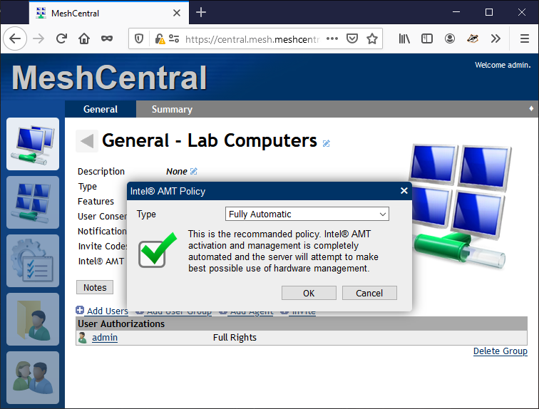
MeshAgent
Intel® AMT

Slide 6
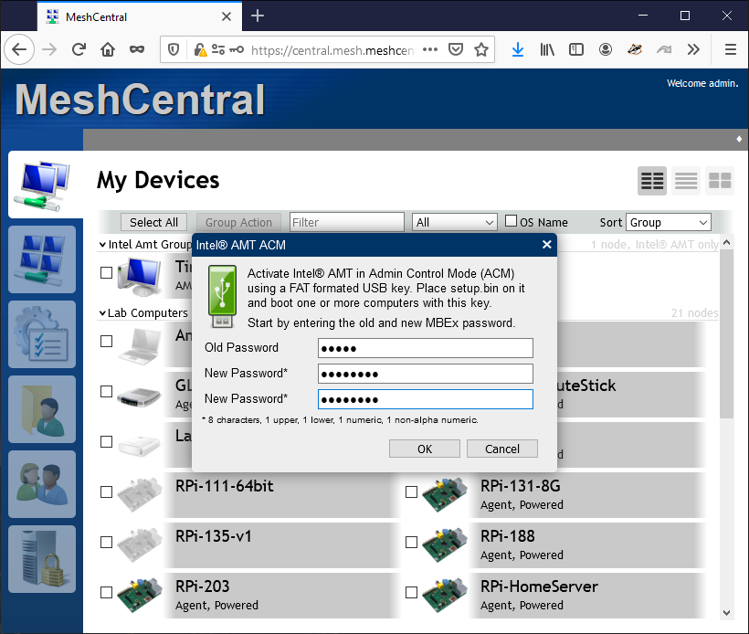

3
ACM Activation
Boot on device and hit “Y”
2
1
Create the key

